Slide 1
UTA ANNUAL CPE EVENT
AUGUST 11,2016
Charles D. Miller, P.C.
Charles Miller, J.D.
Senior Lecturer- UTA College of Business, Department of Accounting

Slide 2
CLASSIFICATION-EMPLOYEE VS. INDEPENDENT CONTRACTORS
Form 1090 vs. Form W-2
If “employee” receive:
  FICA contributions
  Workers Compensation Coverage
  Protections of Title 7 and Other Discrimination in Employment Laws
  Other protections e.g. final paycheck payment deadline, whistleblower, wrongful termination, etc.

Slide 3
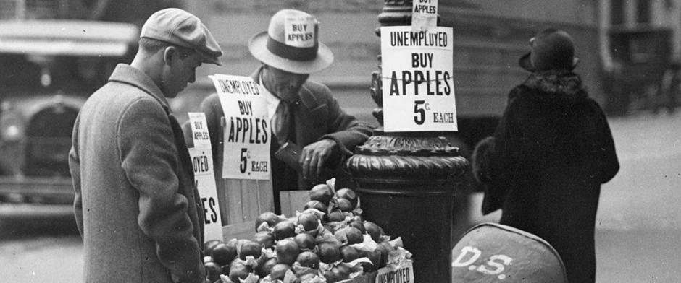
FAIR LABOR STANDARDS ACT (FLSA)
1930s reaction to Depression Era
“Minimum Wage”: Depression-Era Reaction

Slide 4
1932-INTRODUCED
1938-ADOPTED
US Congress-Used Interstate Commerce Clause (commerce among the several states”) as source of power to reach employers
40-hour week
Overtime for hours exceeding 40 in week
OT Exemptions-administrative, professional, executive OT exemptions
Minimum based on food/clothing/shelter to maintain a family of four?
Today- (52 weeks x 40 hours=2,080 hours); 2080 x $7.25=$15.080
Clearly, inadequate!
Prior job -$1.75 in 1974/75 as “male nursing assistant.”

Slide 5
FLSA-VERY MUCH AMENDED/DEBATED
Only US Congress can raise minimum
Ongoing battles e. ,g, break time, uniforms, meal periods,etc.
Politics- Wage increases ”eliminates jobs” vs. broad public wealth improvement
800-pound guerilla: “Ripple effect upward e.g if raise minimum wage raises all wages
Public policy implications e.g. Minimum wage rate in China is $1.75/Hour
PPP-Purchasing Power Parity

Slide 6
“LIVING WAGE” MOMENTUM
New York ($15.00/Hour by 2020, $15.00/Hour in NYC by 2018)
California-$10.00/Hour; $15.00/Hour by 2022
Los Angeles; 7/1/16 became $10.50; $15.00/Hour by 2020
Washington D.C.-$15.00/Hour by 7/1/2020
Certainly an easy “campaign promise” to make to constituents
Is US Congress wiser-or just more of same-old gridlock?

Slide 7
RESULT….
Federal courts extremely pro-wage increase by any means e.g. classification issues (e.g. Alexander vs. Fed Ex case)
US Government-Uses executive branch agency regulatory power to increase “wages” via interpretation and substantive rulemaking at any opportunity.

Slide 8


INTERNSHIPS/TRAINEES
Originally intended for “shadowing” employees e.g. entertainment
Exempt from minimum wage requirements
Job market-internships highly sought
Abused by employers-”Go and help out in parking lot with tash.”
2010-USDOL clarifies with Memorandum
  Must benefit intern –no immediate afvantage to company
  Both parties understand
  Not doing regular work of employees/displacing them
  Provided in educational environment

Slide 9
WHITE COLLAR EXEMPTION
Salary basis i.e. fixed amount
Salary level-above $ amount as floor
Executive/administrative/professional
Over years-salary level lagged behind
Starbucks case-Barrista to Assistant Manager
“Congratulations Bill, you are now in management!
P.S. “No OT so less compensation!”

Slide 10
WHITE COLLAR OT EXEMPTIONS
2014-President Obama asks US DOL to update regulations re OT for white collar persons
Federal Register-NPRM in Federal Register Notice given of proposed rules on July 6,2015
Minimum annual salary to obtain exemption-Was $23,660 ($455 per week) with proposed rule to increase to $47,476 ($913 per week)

Slide 11
FINAL RULE ANNOUNCED -MAY 18,2016
OT exemption begins at $47,476 annual salary
Thus- More “exempt employees now get OT as fewer make over $47,476
All “white collar managers, making less than $47,476 will get OT
Estimated 4M to get OT as of December 1,2016

Slide 12
OTHER ISSUES
Employer can use nondiscretionary bonuses and incentives for up to 10% of amount
Tied to 40% of average full-time salaried worker in census region as justification
Highest compensated salaried employees amount to be at 90th percentile or $134,004
Automatic adjustments every 3 years to maintain percentile rankings

Slide 13
DONNA KASMAN V KPMG-2011
Much media attention in accounting industry
Allegation of gender discrimination and Equal Pay Act
Class action-1,000 members and “projected” 10,000
Claims
Fewer % of females make Senior Manager than industry average
  Fewer women make Partner than industry average
  Women managers tracked to non-partnership paths
  Women paid less

Slide 14
RECENT EVENTS- 2016
Class membership expanded with more named plaintiffs added in March
Estimated settlement value $250-350 in n2015
Now-$400M
Impossible to know what is going on as an outsider
Battle of PR firms/press releases
Class goes back to 2008 on tolling of limitation periods
www.sanfordheiser.com

Slide 15
EMPLOYEE VS. INDEPENDENT COTRACTOR
Much publicized issue e.g. IRS Publications 1779, Publication 15-A,
Form SS-8 (Determination of Worker Status)
Voluntary Classification Settlement Program (VCSP)
State common law/court decisions
“Control test”-Right of company to control manner and means of obtaining results desired
ALL THAT MATTERS IS WHAT PERSON DOES-NOT WHAT BADGE OR HR MANUAL STATES.
In reality-classification by employer does not define answer

Slide 16
ABRAHAM LINCOLN QUOTE
If you call a dog’s leg a tail, how may legs does a dog have?
Four
Calling a dog’s tail a leg does not make it a leg.

Slide 17
ALEXANDER v. FEDEX - 2015
9th circuit decision
Major lawsuit filed by drivers for Federal Express Ground Package System
Issue was litigated issue in several forums
No real dispute about facts (“Light was red…..no, green….no red!)
Applied to 2,300 California drivers
Class action with 2,300 drivers/former drivers
Narrow legal issue- on which what side of a gray line will drivers fall?

Slide 18
BACKGROUND
All drivers sign Operating Agreement with self-serving language
Drivers do package deliveries in 1-2 Service Areas
No set hours-but must work 9.5-11 hours by estimated load
FedEx trains drivers; ride-along 4 performance evaluations per year
Must follow FedEx “Safe Driving Standards”
Drivers own /maintain own vehicles; FedEx controls appearance
Drivers wear FedEx uniforms-must meet FedEx grooming standards
FedEx provides “Business Support Package” e.g. uniforms, scanners, other equipment and deducts from paycheck.
Multi-year contracts; terminable for cause and arbitration,

Slide 19
FEDEX ARGUMENT
Multi-year OA (1-3 years) with renewals-language!
Can fire driver at will-this makes evidence of IC
Provide tools in Business Support Package
No defined “on clock” hours
Compensation based on performance e. g, loads, deliveries, etc.
Drivers can take on more Service Areas, hire helpers/vehicles
We offer “entrepreneur” opportunities-sky is the limit

Slide 20
COMMENTS
Odd case procedurally-MDL leads to consolidating cases all over CA.
Ruled for FedEx-No ”genuine issue of materials fact.”
9th circuit takers case on appeal
Overrules trial court-could have sent it back for trial
Instead overruled AND then entered victory for Plaintiffs base on “no genuine issue of material fact.”
Settled soon thereafter for $ 228M
Guide to all companies elsewhere!
Consistent with “favoring” plaintiff re broader coverage!

Slide 21
PIPPINS v. KPMG
2nd circuit Case in 2014
FLSA excludes “ white collar professionals” from OT requirements
“Bona fides professional capacity” persons are exempted
Similar to “executive” status exemption and “administrative” persons
DOL Regulations-29 CFR Section 541.301 states:
  “..an employee’s primary duty must be the performance of work requiring advance knowledge in a field of science or learning customarily acquired by a long course of specialized instruction..”

Slide 22
THREE-PRONG “PROFESIONAL” TEST
Work is predominantly intellectual in character
Requires consistent exercise of discretion and judgment
Specialized academic training is a standard prerequisite for entry into the profession.
Other Regulations make clear bookkeepers, clerks and others doing routine work called “Accountants” may not be “professionals.”
“Professionals” who are accountants not limited to CPAs only

Slide 23
FACTS
KPMG employees are “Audit Associates”
Work long hours on team preparing client audit opinions
Believe that are not “professionals”
Automatic promotions after 2 years if satisfactory performer.
Duties: Inventory observation, walkthroughs with client re internal procedures, work paper preparation.
WHAT ARGUMENTS WOULD THEY MAKE IN LIGHT OF REGULATIONS?

Slide 24
THEIR ARGUMNENTS
We are just clerks/bookkeepers-not truly accountants
Everything we do has multiple reviews-no real exercise of discretion
We are just passing along information
Work is devoid of any specialized skills-all templates and guidelines
KPMG taught us all we needed to know at in-house training, thus really no “advance knowledge” used or even needed.
Yes, accountants are professionals. But, we are not really accountants.”

Slide 25
COURT OPINION
Plaintiffs “ being an entry-level member of a profession with not being a professional at all.”
Takes advance knowledge just to look at records
Always encouraged to have a “questioning mind” and “think” about what looking at, don’t just always take at face value. Judgment!
So what- “Passing along” errors/anomalies is part of the audit process!
Doctors/lawyers supervise junior staff-why not accountants?
Nature of task-discretion exercise may be more important in other jobs e.g. executive managers. Here, focus on advance knowledge!
Senior managers do some of work-so what, natural overlap.

Slide 26
ALSO
Vast majority of Audit Associates have accounting degrees
All are or will be expected to become CPAs
Fact that a non-Accounting major may be hired does not mean NONE have “specialized instruction.”

Slide 27
RESULTS
Plaintiffs lose.
In hindsight, not a good case to have litigated since accounting by Regulation is a “learned profession.”
Historically, legal conflict re bookkeepers, financial document reviewers and clerks” claiming they are not accountants even though called that.
Here-Called accountants (assumed professionals) but really are not “Professionals.”
Aren’t they denigrating/trying to dumb down their own profession bnyt focusing on discrete tasks?

Slide 28
MICRO-AGGRESSIONS
A subtle but offensive comment or action directed at a minority that is often unintentional or unconsciously reinforces a stereotype
Examples:
  You don’t look American. Are you?
  You are all really good dancers.
  So, how can you look so Mexican but not know Spanish?
  You really are a lot smarter than I guessed you would be.

